Slide 1

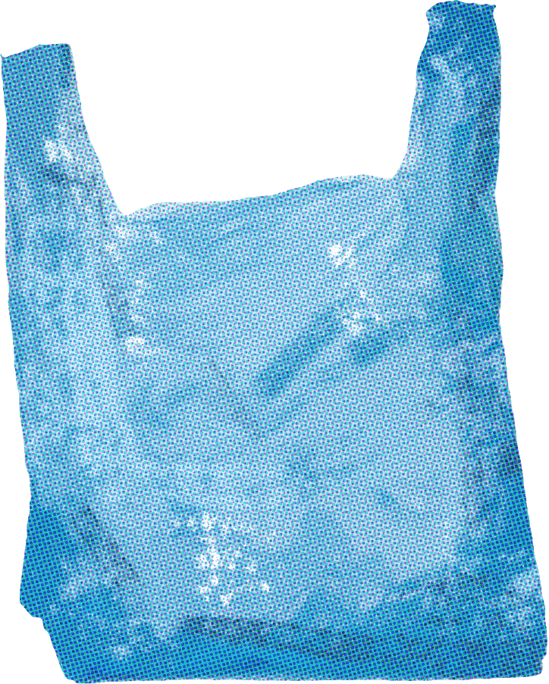
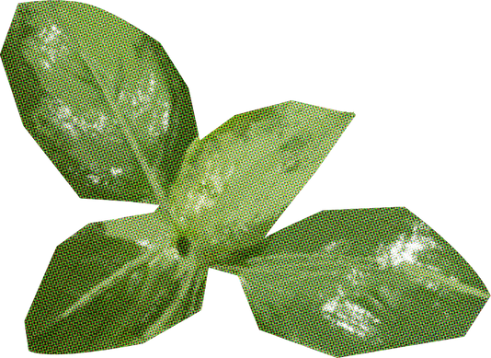

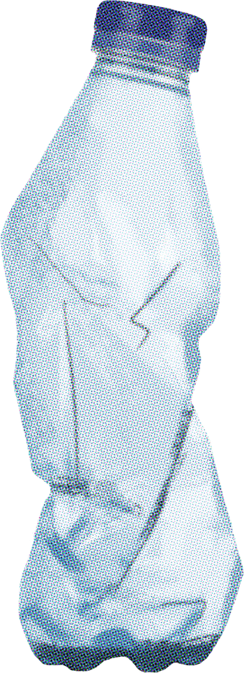


REDUCE
Recycle
Reuse
Waste Well: Plastic Recycling for a Better Future

Slide 2
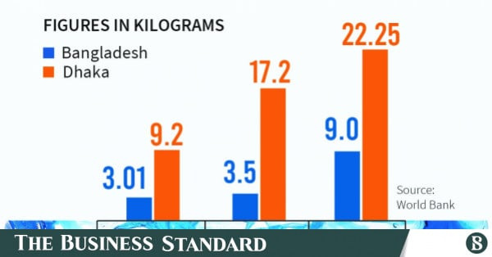



PROBLEM STATEMENT
Introduction
In Dhaka, about 646 tonnes of plastic
waste are collected daily -
this is ~10% of the city’s total waste. (Source :The daily observer)
Nationwide: ~21% of single‐use bottles recycled; ~79% mismanaged.
This data shows a critical gap between plastic consumption and sustainable disposal. It highlights strong need for improved collection, recycling and reduction of single‐use plastics.

Slide 3
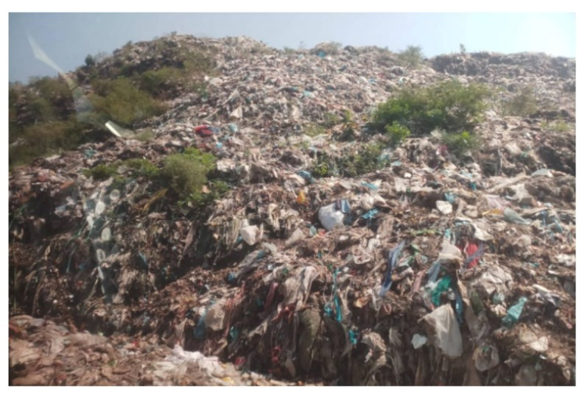




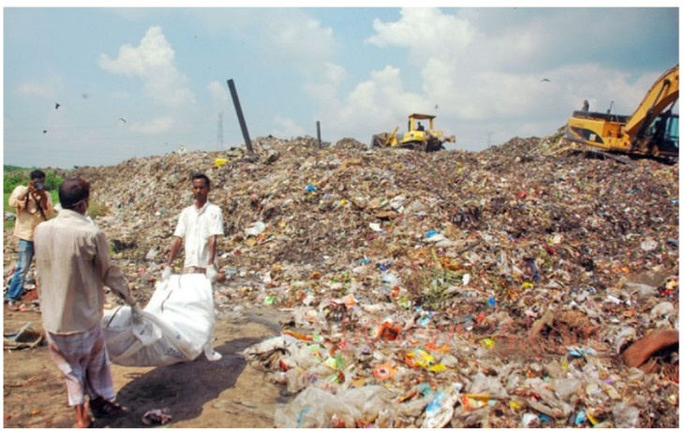


Challenges:
1. Poor Waste Segregation:
Most households mix all waste together → lowers recycling quality.
2. Limited Collection Infrastructure:
City corporations lack enough trucks, bins, and manpower.
3. High Transport & Processing Costs:
Moving waste to recycling plants is expensive; small startups can’t afford it.
4. Informal Recycling System:
Waste pickers work in unsafe conditions with no recognition or fair pay.
Dumping Station at Mauli,Dhaka
Develop recycling technology.
Dumping Station At Halishahar,Chottogram

Slide 4
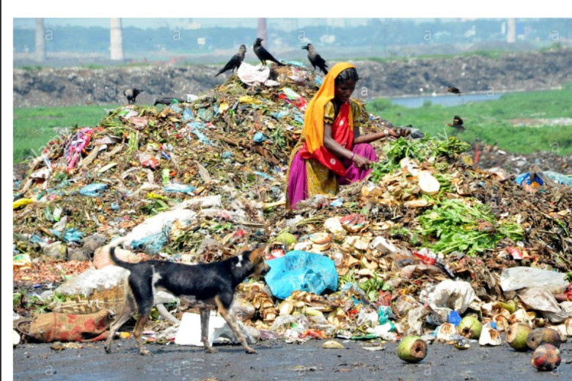
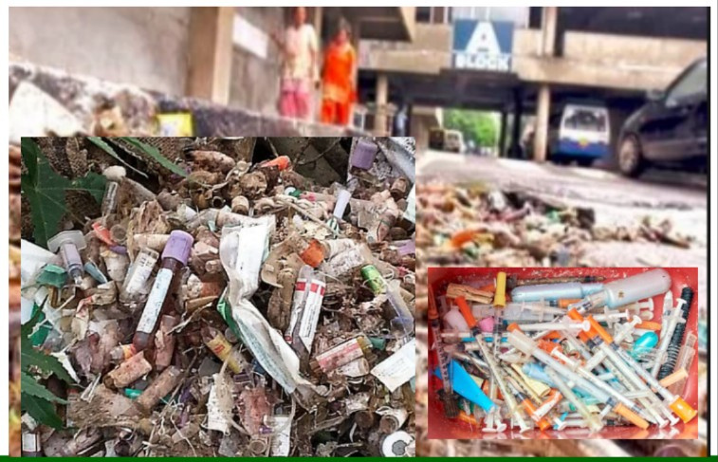
Challenges :
5. Low Public Awareness:
People don’t know the value of recycling or how to separate plastics.
6. Lack of Policy Support & Incentives:
Few government incentives for green businesses or waste segregation.
7. Poor Market for Recycled Products:
Recycled materials often seen as “low quality,” reducing buyer interest.
8. Financial & Technical Barriers:
Limited funding, modern equipment, and innovation in recycling sector.

Slide 5

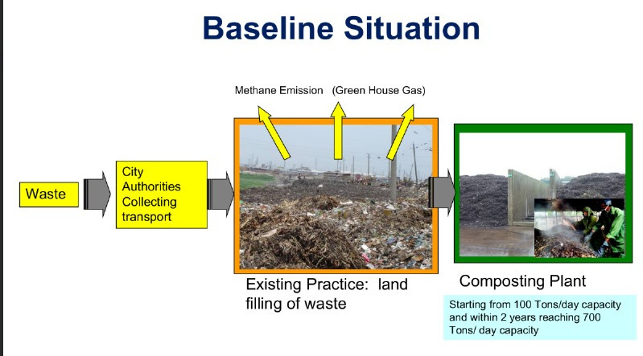


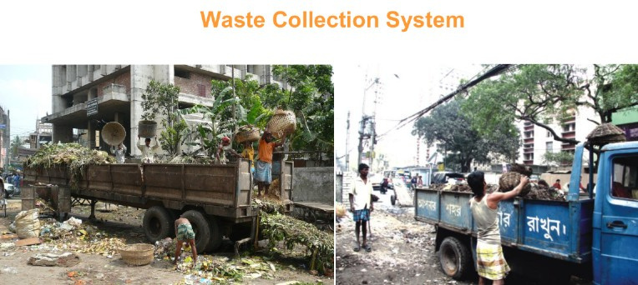
OUR SOLUTION :
SMART PLASTIC RECYCLING HUB
Create localized mini recycling hubs in cities to collect, sort, and process plastic waste efficiently.
Use IoT-enabled smart bins for waste tracking
Partner with municipalities and schools for awareness drives
Community buy-back system (earn money/cash for returned plastics)

Slide 6
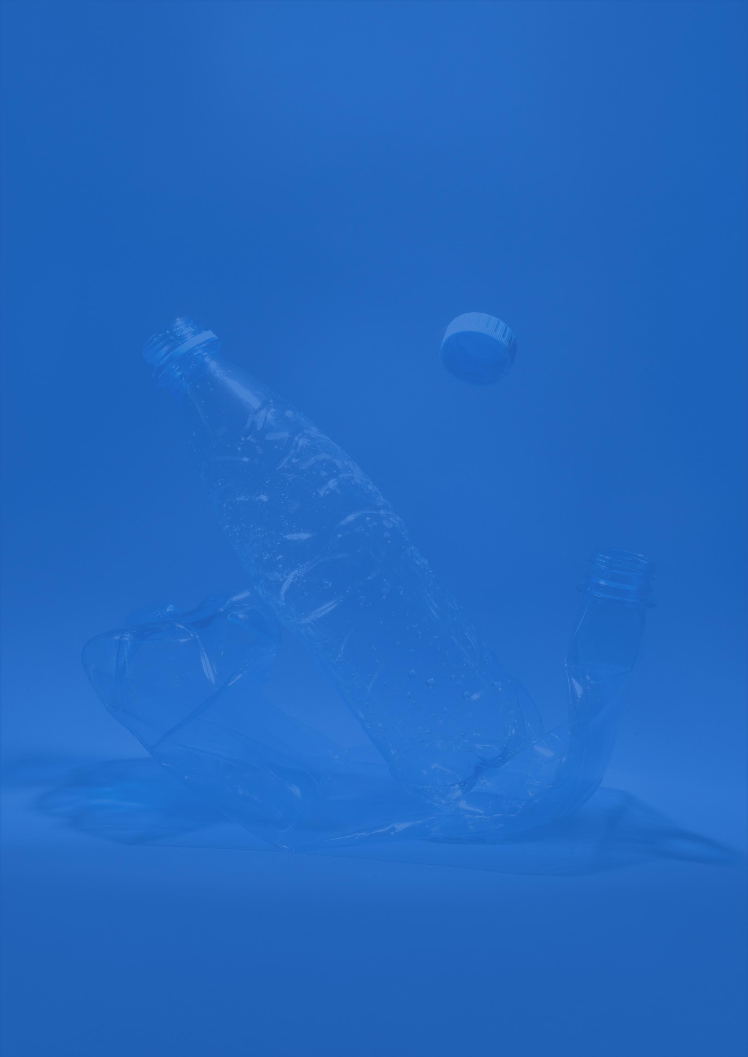

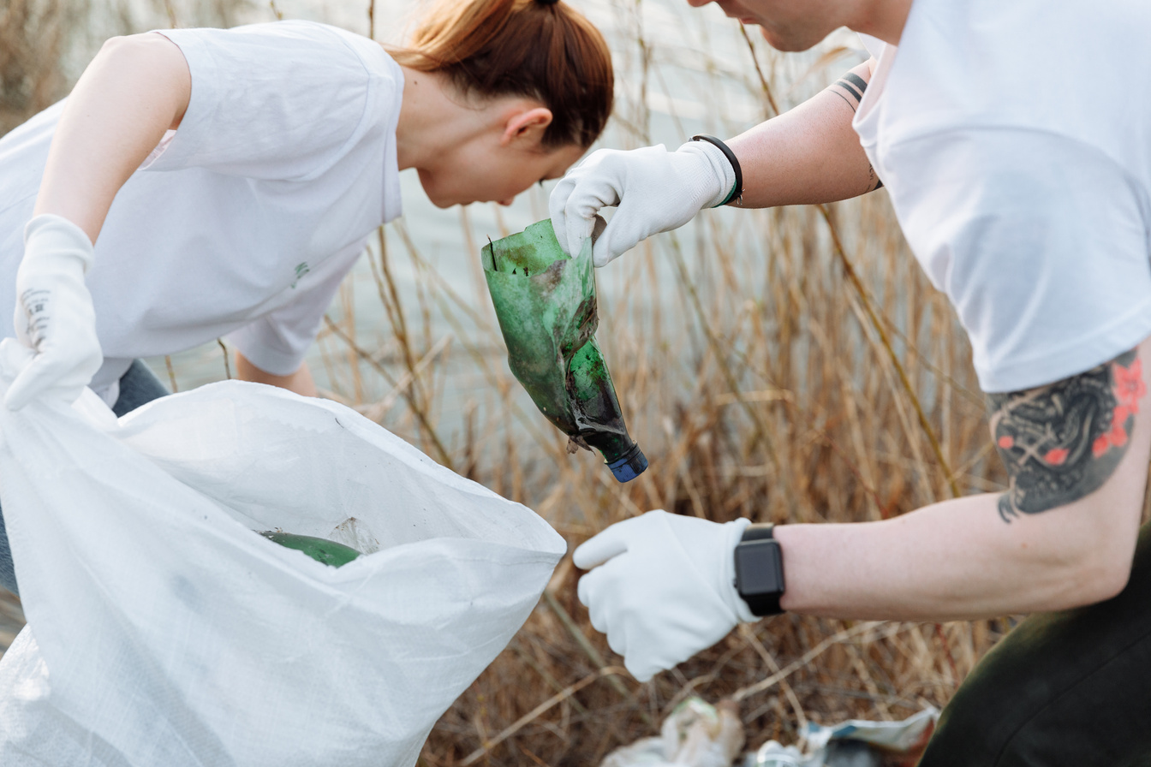
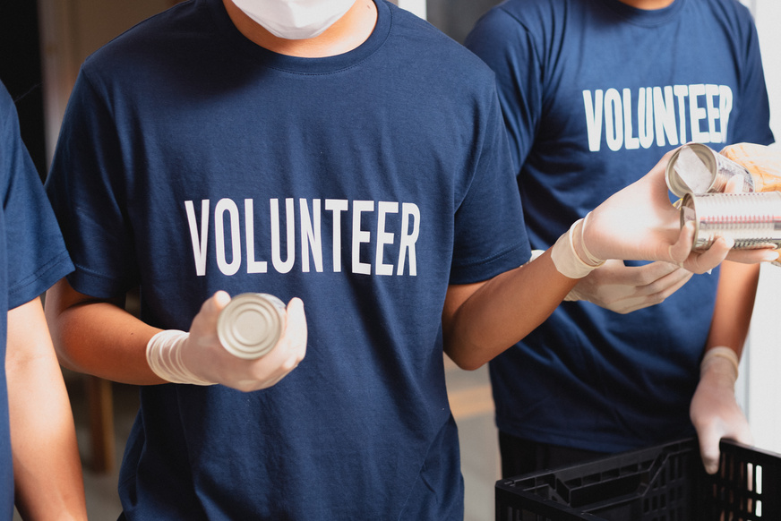
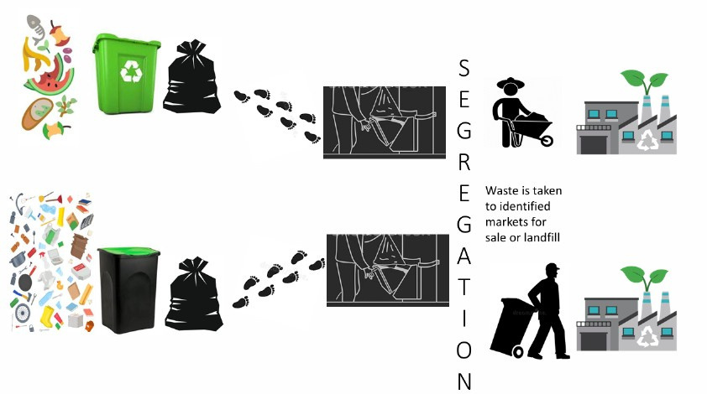
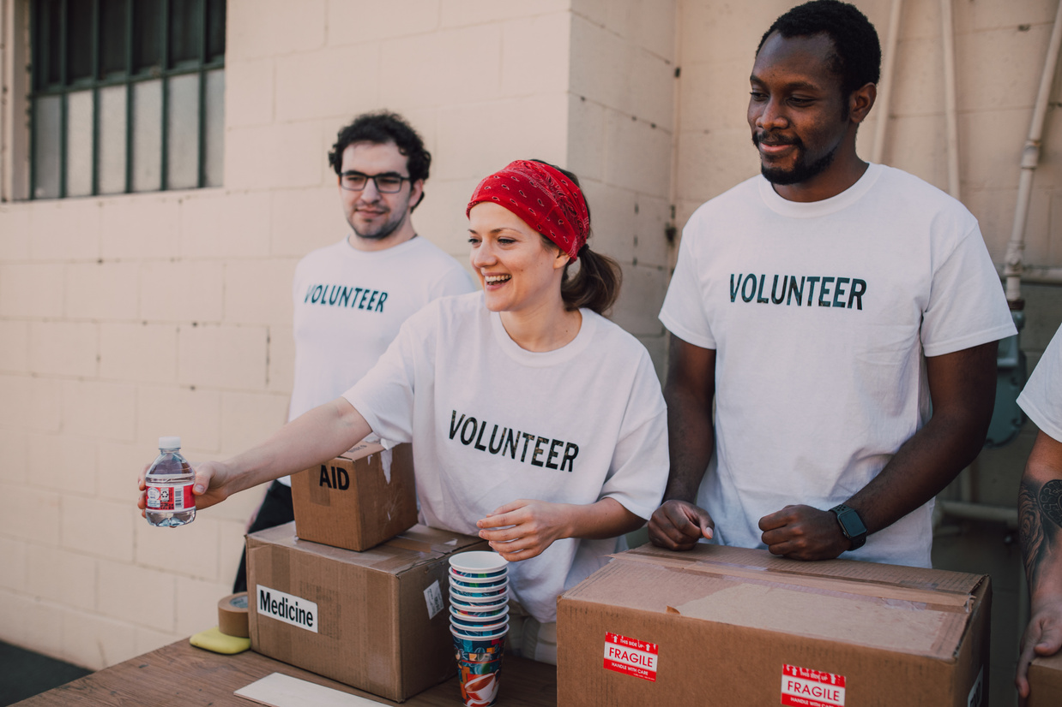
Our Solution Green Pods :
Green Pod Features
PLACED AT SOURCE:
WHAT ARE GREEN PODS?
MOBILE, SELF-CONTAINED UNITS THAT ENABLE COMMUNITIES TO PROCESS PLASTIC WASTE LOCALLY, MAKING RECYCLING ECONOMICALLY VIABLE AND ENVIRONMENTALLY SUSTAINABLE.
LOCATED WHERE PLASTIC WASTE IS COLLECTED, ELIMINATING EXPENSIVE TRANSPORTATION COST
COMMUNITY OPERATED:
REQUIRES MINIMAL TRAINING TO OPERATE, CREATING LOCAL EMPLOYMENT OPPORTUNITIES
VALUE CREATION :
CREATES VALUABLE PRODUCTS FROM WASTE PLASTIC, PROVIDING INCOME FOR LOCAL COMMUNITIES
IoT Enabled Integrated with Industry 4.0 technology for monitoring and optimization

Slide 7
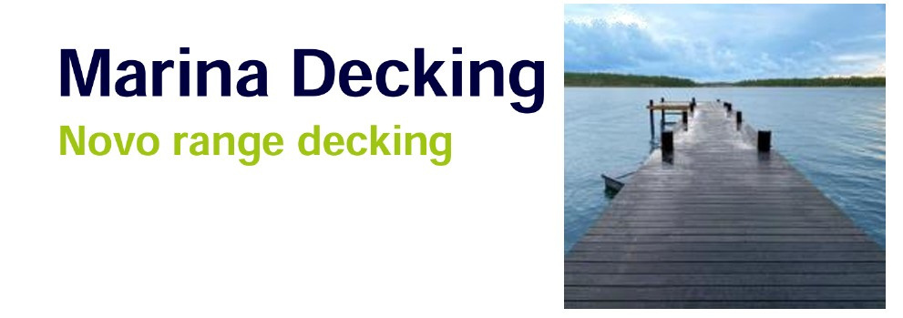
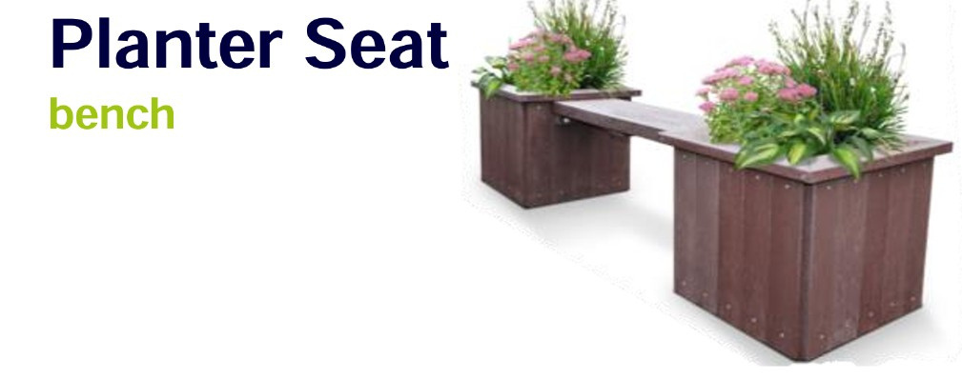

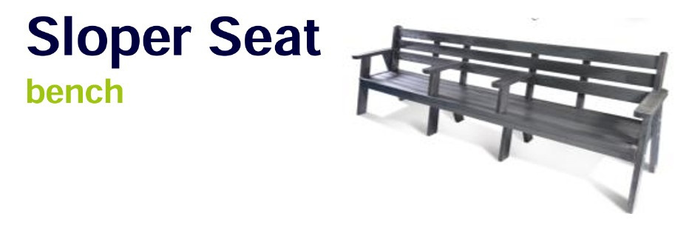
ECO FRIENDLY PRODUCTS:
TO PROVIDE AFFORDABLE, SUSTAINABLE HOUSING SOLUTIONS USING RECYCLED AND GREEN MATERIALS.
WE AIM TO REVOLUTIONIZE CONSTRUCTION IN BANGLADESH BY OFFERING STRONG, ECO-FRIENDLY, AND LOW-COST PRODUCTS, BUILDING A CLEANER AND GREENER FUTURE.
PLASTIC IS PRECIOUS

Slide 8
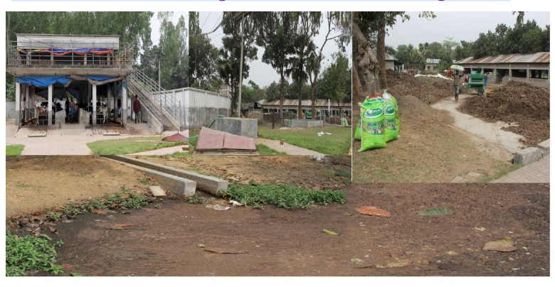
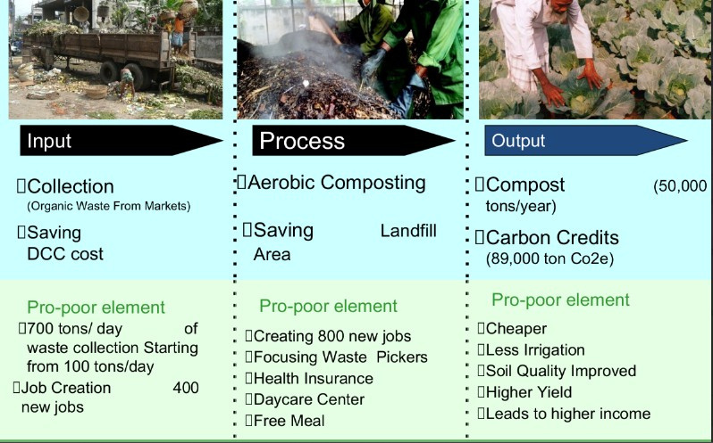
Waste to value through better Waste Management
Builds cleaner and healthier urban environments
All Kinds of Waste Collection and Converted to Energy

Slide 9
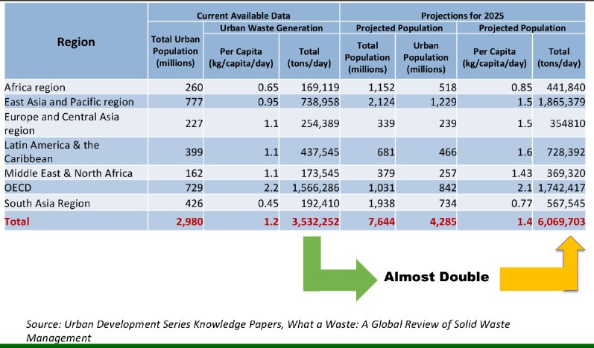
Financial & Environmental Impact
“NOW WE EXPLORE BUSINESS OPPORTUNITIES AND STRATEGIES FOR TURNING THIS ‘WASTE’ INTO VALUE THROUGH RECYCLING, CIRCULAR ECONOMY AND INNOVATION.”
Low setup cost compared to large plants.
Revenue from recycled product sales.
Reduces municipal waste burden.
Supports SDG 11 (Sustainable Cities) & SDG 13 (Climate Action).
.

Slide 10
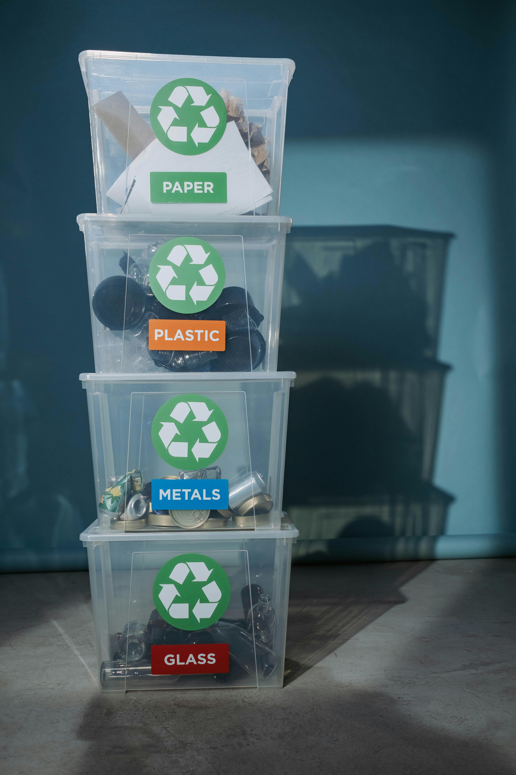




Bangladesh needs smart, community-driven recycling.
Recycling plastic isn’t just waste management — it’s a green business opportunity for a cleaner, more sustainable future.
Thank You
GET IN TOUCH
+123-456-7890
WWW.REALLYGREATSITE.COM
HELLO@REALLYGREATSITE.COM
123 ANYWHERE ST., ANY CITY, ST 12345

